Slide 1
EXPERIENCES OF TESTING WOUNDS FOR BACTERIAL PROTEASE ACTIVITY IN A COMMUNITY SETTING
Deborah Baines¹, Mkyla Reilly², Brenda Pimlott³ & Marissa Carter⁴
1. Senior Clinical Trial Nurse, Adult Haematology Oncology Research Team, Manchester 2. Research Nurse, NIHR Clinical Research Network (Greater Manchester)
3. Senior Research Coordinator & GCP Facilitator, Pennine Care Foundation NHS Trust, 4. President, Strategic Solutions, Inc

Slide 2
Clinical and Economic Effectiveness of Testing Chronic Wounds for Bacterial Protease Activity (BPA) using WOUNDCHEK™ Bacterial Status: A Pragmatic Randomised Clinical trial¹
Study performed at Pennine Care NHS Foundation Trust (latterly Northern Care Alliance) funded by Woundchek Laboratories Ltd supported by grants from Greater Manchester Academic Health Science Network (now Health Innovation Manchester) and Innovate UK
Conflicts of interest declaration: Deborah Baines participation in EWMA 2020 is funded by Woundchek Laboratories.
¹Clinicaltrials.gov: NCT03678636, CRN CPMS ID: 41006, IRAS: 232299

Slide 3
Methodology
Community patients
Main inclusion criteria: wound >4 weeks old, >18yrs age, wound area >1cm², Not infected, Not being treated with antimicrobials
Patients enrolled
Aug 2018 - Dec 2019
N=143
2 arterial ulcers, 7 foot ulcers, 1 mixed leg ulcer, 1 pressure ulcer, 48 venous leg ulcers & 41 ulcer aetiology undefined
BPA positive
N=100
Silver dressing chosen from formulary.
Type dependent on wound condition
Intervention
2 weeks Antimicrobial
N=50
Control
Standard care
N=50
1) Wounds healed, 2) Percent wound area reduction , 3) Antibiotic usage, 4) Change in EQ5D-3L & 5) Nursing time
50 Control patients completed the study and 47 in the Intervention group (one patient withdrew and two died).
Outcomes at 12 weeks

Slide 4
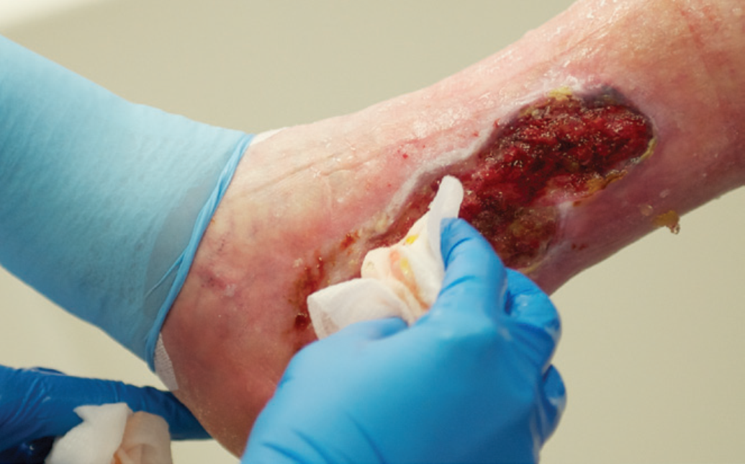
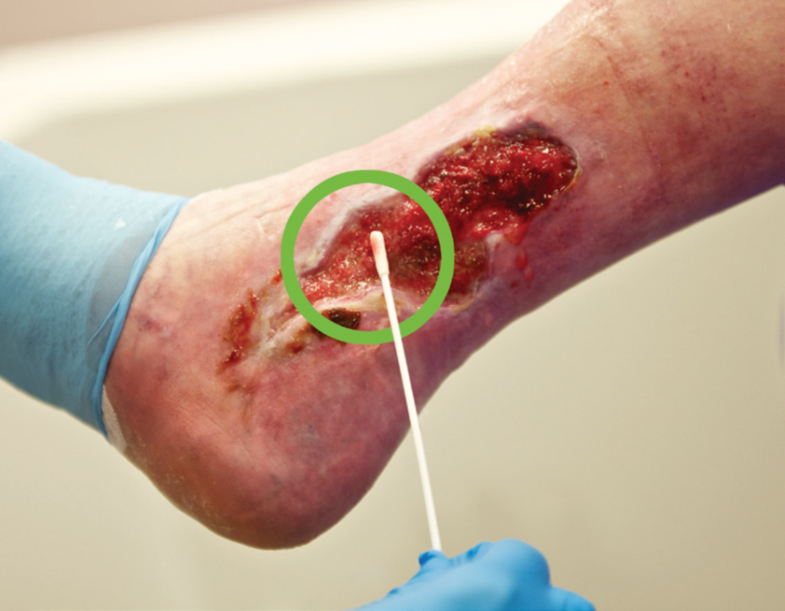
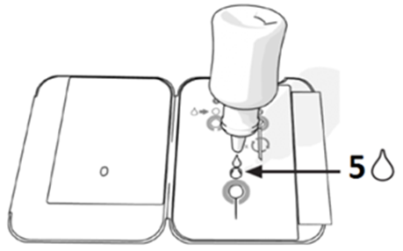
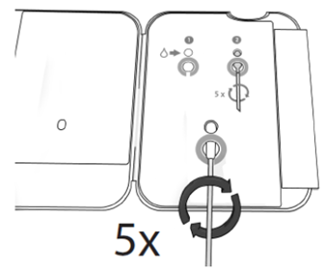
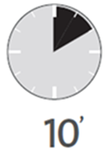
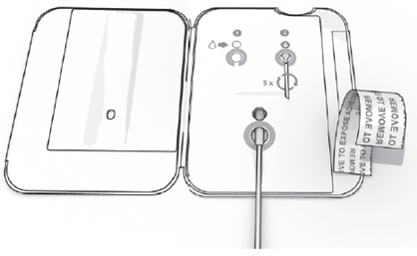
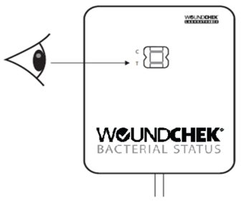
Bacterial protease activity (BPA) test
Test was conducted in clinic settings or in the patient’s home.
The test takes 15 minutes
Easily incorporated in the clinic setting but required more strategic planning for District Nursing home visits.
Test was generally well tolerated and anecdotal reports from patients showed they perceived the test indicative of proactive wound management regardless of the test result.

Slide 5
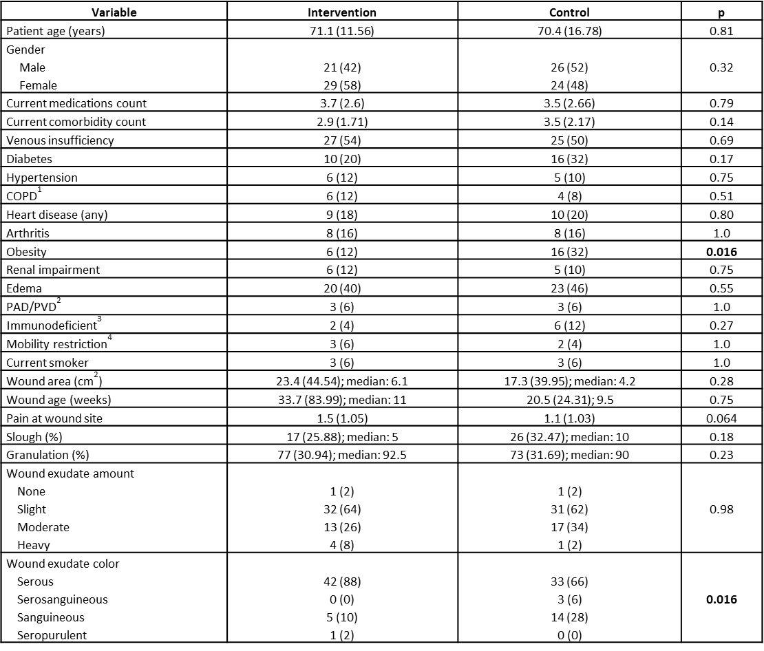
The groups were well
matched at baseline
The only imbalances were:
More obese persons in the Control group (16%) compared to the Intervention group (6%) (p=0.016)
Intervention group had more cases of serous and less cases of sanguineous compared to the Control group (p=0.016).

Slide 6
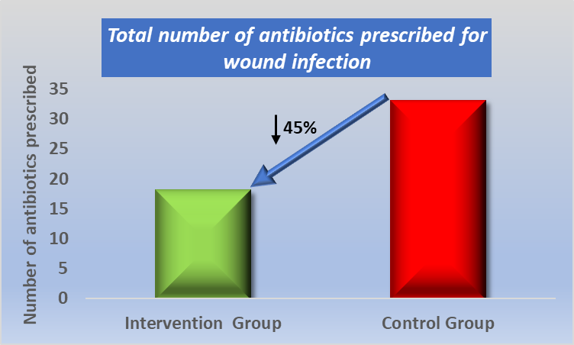
Antibiotic prescribing trended in favour of Intervention
The Intervention Group had less numbers of antibiotics prescribed for index wound-related infections compared to the Control Group
Intervention: 0: 37 (74%); 1: 9 (18%); ≥2: 4 (8%); Control: 0: 29 (58%); 1: 12 (24%); ≥2: 9 (18%); p=0.068.

Slide 7
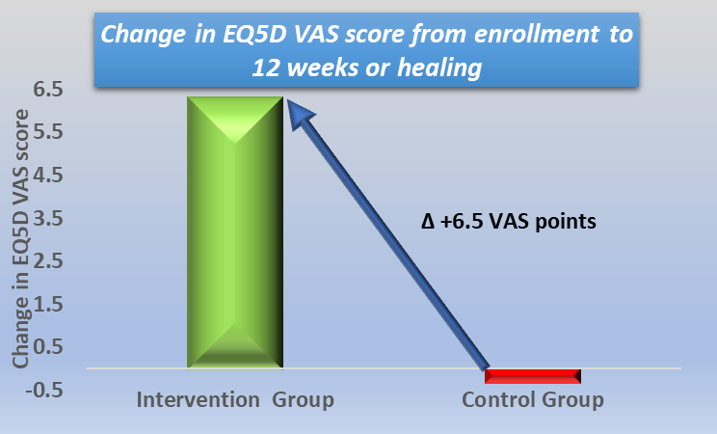
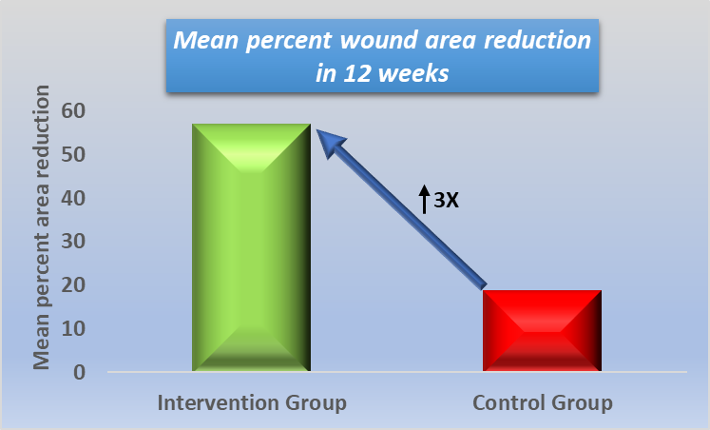
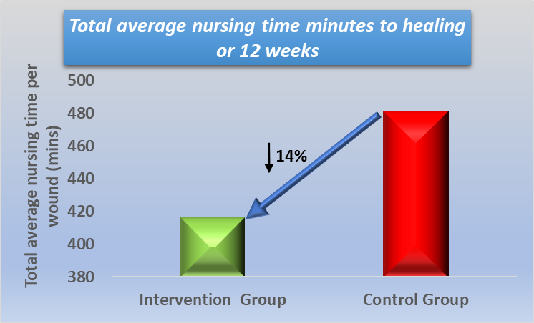
Wound area reduction, Quality of Life and nurse time all trended in favour of the Intervention Group
Mean percent wound area reduction was 56.74% (SD: 81.64) in the Intervention Group compared to 18.50% (SD: 209.56) in the Control Group; p=0.23.
The mean change in the EQ-5D VAS score between baseline and up to 12 weeks of treatment was 6.2 (SD: 16.60) in the Intervention Group compared to -0.3 (SD: 19.58) in the Control Group; p=0.078.
The total nurse time spent with each subject during 12 weeks of treatment was 416 minutes (SD: 180.13) in the Intervention Group compared to 481 minutes (SD: 231.69) in the Control Group; p=0.124 .

Slide 8
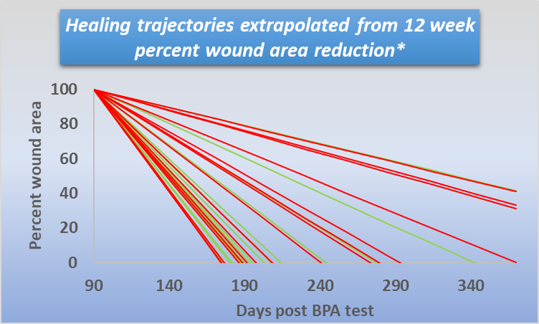
Significantly lower annualised nurse time for Intervention Group
Linear model used to extrapolate wounds not healed in 12 weeks to projected time to healing to calculate annualised nurse time and materials usage¹
28.3% (95%CI 2.1- 54.5%) less nurse visits predicted for the Intervention Group. Average 43 (SD: 24.54) nurse visits versus 60 (SD: 30.53) for the Control Group (p=0.0346).
Material spend¹ trended lower for the Intervention wound; on average £124 less compared to Control Group (p=0.3749).
* NB. 7 Intervention Group wounds and 11 Control Group wounds increased in size in first 12 weeks not extrapolated and assumed to be unhealed at one year.
¹Guest JF, Ayoub N, McIlwraith T, et al. Health economic burden that wounds impose on the National Health Service in the UK. BMJ Open 2015;5: e009283. doi:10.1136/bmjopen-2015-009283

Slide 9
Conclusion
The BPA test was easy to perform and well tolerated by patients.
Wound area reduction and nursing time in 12 weeks trended in favour of the Intervention Group
Reduced antibiotic prescribing and quality of life improvement were close to reaching statistical significance in favour of the Intervention Group (p=0.068 & 0.078 respectively).
Testing for BPA may improve patient quality of life and reduce antibiotic prescribing.
BPA testing significantly reduced predicted resource utilisation (p=0.0308).
Potential to reduce burden on healthcare systems

Slide 10
THANK YOU FOR LISTENING

